Slide 1

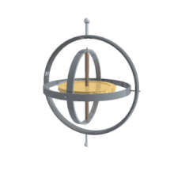
INSTITUTE OF ENGINEERING AND TECHNOLOGY
Project Presentation (Group – 1 )
Self-balancing of wheel with the help of Gyroscopic effect
Guided by- Dr. Suwarna Torgal
Group Members-
17M7008 Amulya Jain
17M7044 Rishabh Saluja
17M7048 Shivanshu Shukla
17M7059 Trapti Shakya

Slide 2
Introduction -
Our aim is to design and fabricate a self-stabilizing wheel that can be used in two wheeler to balance it that is both efficient and cheap, we always considered the most simple design and components.
We are using a gyroscopic principle to design a self balancing wheel. Gyroscopic principle
nothing but a real world manifestations of the law of conservation of angular momentum.
The major reasons to use a gyroscope for the stabilization of wheel are:-
1) They make really smaller stabilized system
2) They impart greater stabilization
3) They are accurate and easy to understand

Slide 3
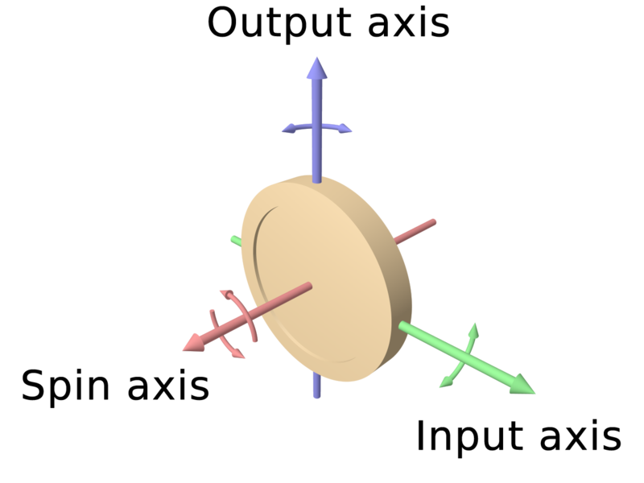
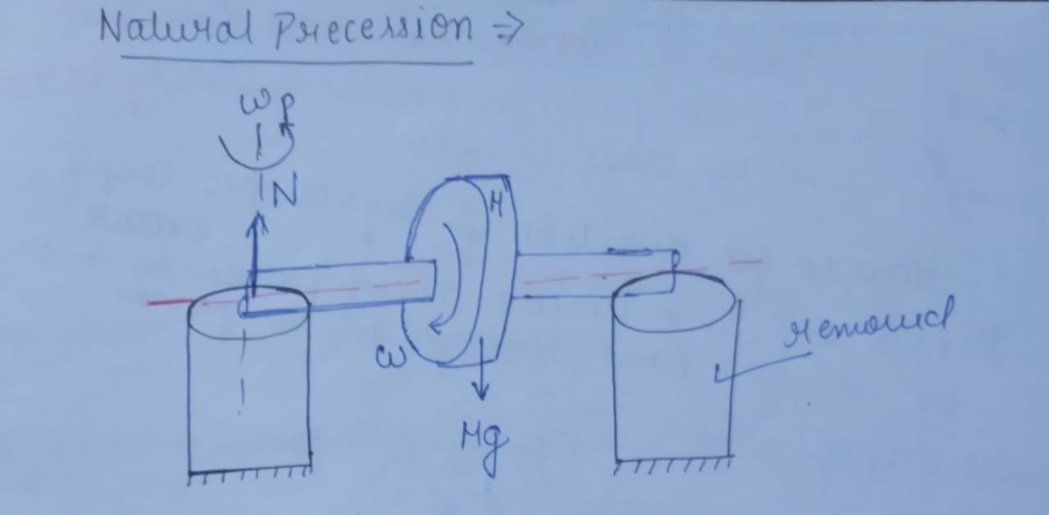
Gyroscopic principle –
Gyroscopes exhibit smooth balancing and accurate analogue readings as they adhere completely to the conservation of angular momentum.
They conserve the magnitude as well as the direction in the absence of an external torque.
The spin axis is always moves in the same direction as that of the applied torque.
The gyroscope can be used to maintain physical stability when the input and output are perpendicular to the spin axis.

Slide 4

Literature Survey-
Many people face difficulty to keep a bicycle upright once it is non-stationary during learning period and some of them drop the idea of learning a bicycle or a two wheeler. When the bike is in motion, disturbances can occur wherein which at high speeds the bike may experience low frequency weaving. On the other hand, at low speeds the bike undergoes high frequency wobbles. The concept of gyroscope can be implemented in the optimizing the control parameters to obtain a smooth flight control even. It can also be used to identify configurations that can help us obtaining most stability for a self-balancing wheel which can help in providing stability to a bicycle.

Slide 5
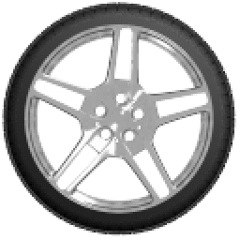
Design-
Design Methodology
2D Sketch
CAD Modeling
FEA & Design Optimization
Procurement of Components
Prototyping & Validation

Slide 6
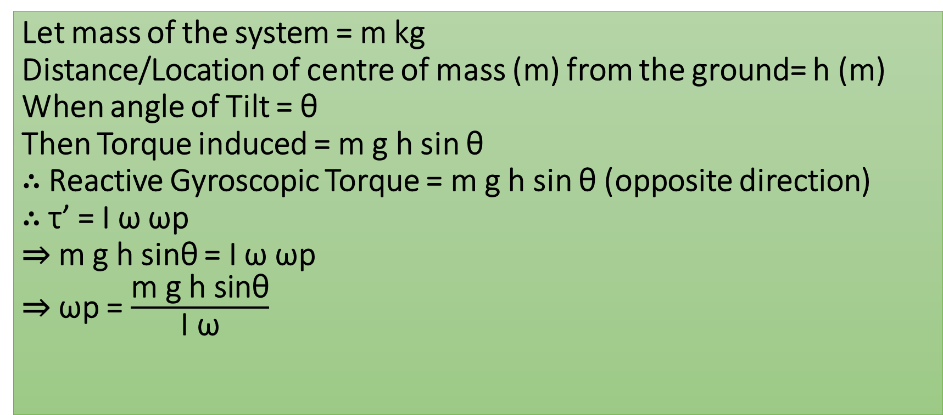
Calculations-
Let mass of the system = m kg Distance/Location of centre of mass (m) from the ground= h (m) When angle of Tilt = θ Then Torque induced = m g h sin θ ∴ Reactive Gyroscopic Torque = m g h sin θ (opposite direction) ∴ τ’ = I ω ωp ⇒ m g h sinθ = I ω ωp ⇒ ωp = $\frac{\text{m} \text{g} \text{h} \text{sinθ}}{\text{I} \text{ω}}$

Slide 7
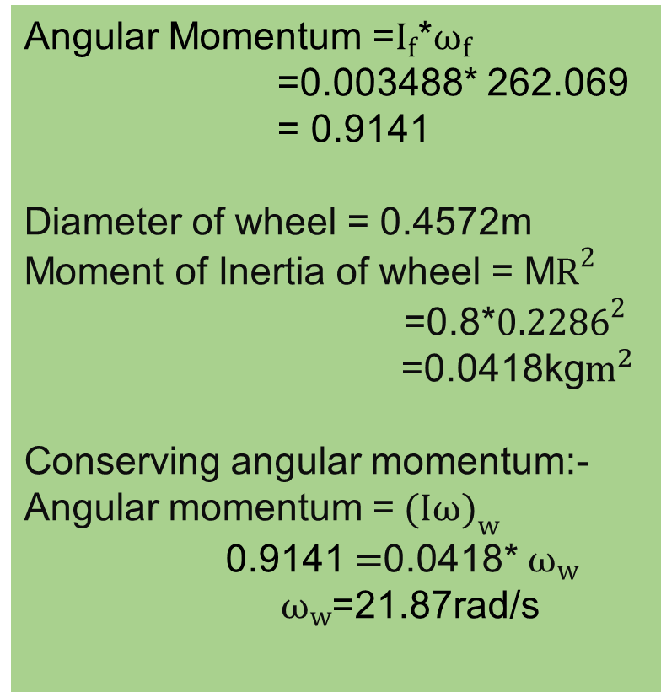
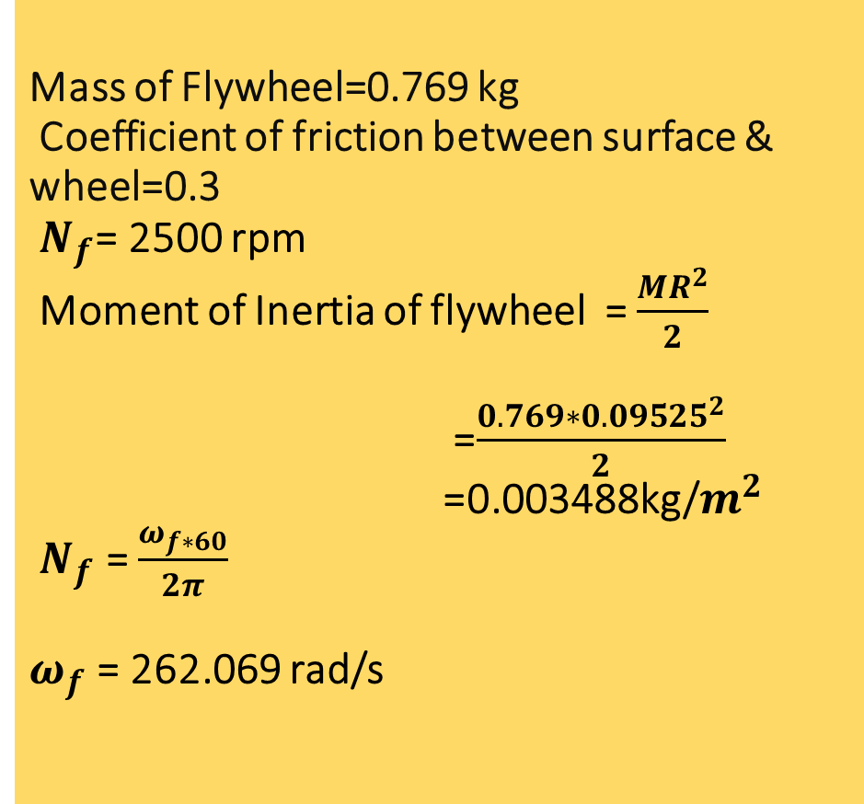
Mass of Flywheel=0.769 kg Coefficient of friction between surface & wheel=0.3 $N_{f}$= 2500 rpm Moment of Inertia of flywheel = $\frac{MR^{2}}{2}$ =$\frac{0.769∗{0.09525}^{2}}{2}$ =0.003488kg/$m^{2}$ $N_{f}$ = $\frac{ω_{f∗60}}{2π}$ $ω_{f}$= 262.069 rad/s
Calculations-
Angular Momentum =$I_{f}$*$ω_{f}$ =0.003488* 262.069 = 0.9141
Diameter of wheel = 0.4572m Moment of Inertia of wheel = M$R^{2}$ =0.8*${0.2286}^{2}$ =0.0418kg$m^{2}$
Conserving angular momentum:-
Angular momentum =${ (Iω)}_{w}$
0.9141 $=$0.0418*${ ω}_{w}$ ${ ω}_{w}$=21.87rad/s

Slide 8
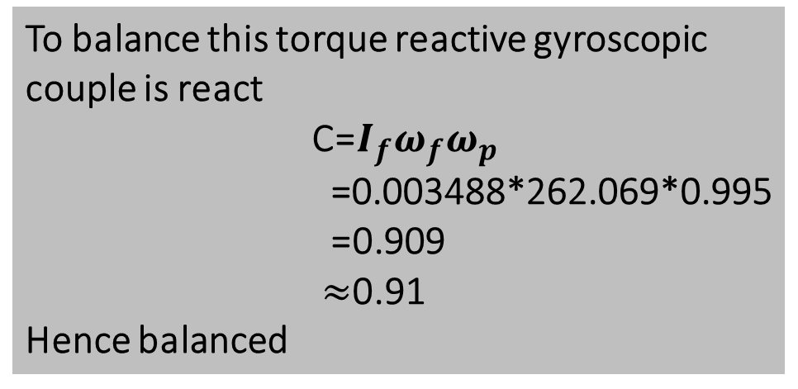
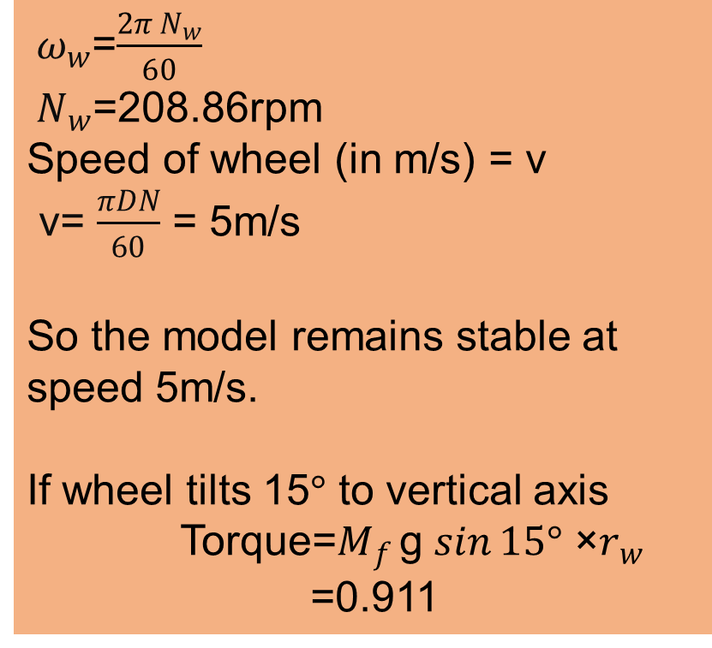
Calculations-
${ ω}_{w}$=$\frac{2π{ N}_{w}}{60}$
${ N}_{w}$=208.86rpm
Speed of wheel (in m/s) = v
v= $\frac{πDN}{60}$ = 5m/s
So the model remains stable at speed 5m/s.
If wheel tilts 15$°$ to vertical axis Torque=$M_{f }$g $\sin{15°}$ ×$r_{w}$ =0.911
To balance this torque reactive gyroscopic couple is react C=$I_{f}ω_{f}ω_{p}$ =0.003488*262.069*0.995 =0.909 $≈$0.91 Hence balanced

Slide 9
Observations-
From our calculations we found that with high RPM hub motor the vehicle/wheel can be stabilized. The disc used as gyroscope was balanced and centred properly to prevent any vibrations and wobbling of the disc.
From the project some certain observations are provided:
The higher the RPM, the bigger the counterforce.
The more the tilt angle, the more force is needed to stabilizes the vehicle.
The direction of rotating wheel tilt determines the force direction of when spinning is in a particular direction.

Slide 10
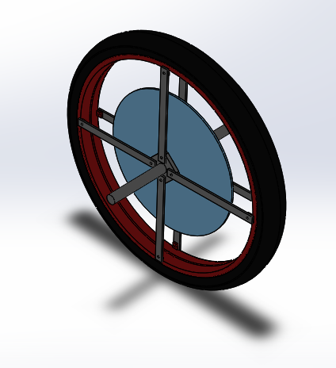
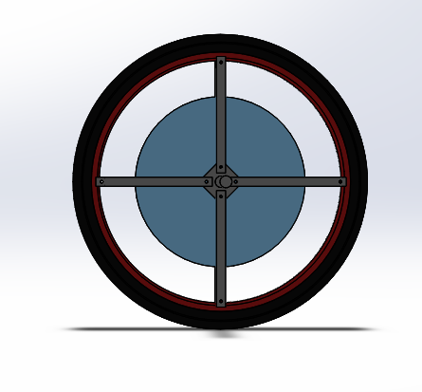

CAD Model -
Design specifications
Wheel Size | 13in
Disc diameter | 7.5in
Disc thickness | 10mm
Disc material | Al6061-t6
Shaft diameter | 0.5in
Shaft length | 10in
Bearing size | 0.5''-1''-10

Slide 11

CAD Model (Video)-

Slide 12
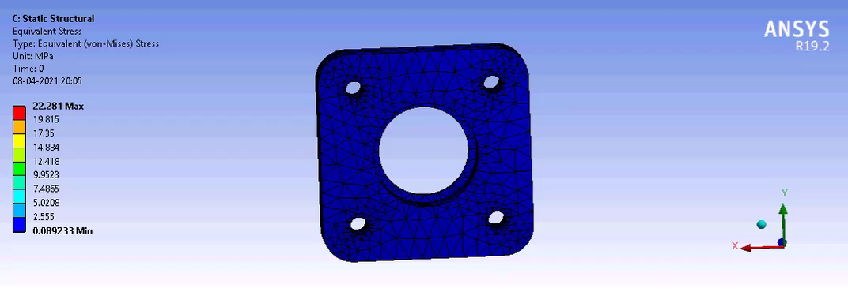
Ansys of Hub-

Slide 13
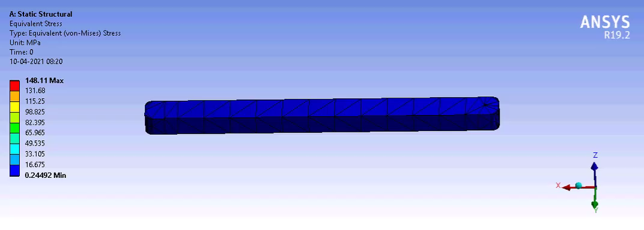
Ansys of cage (spokes)-

Slide 14
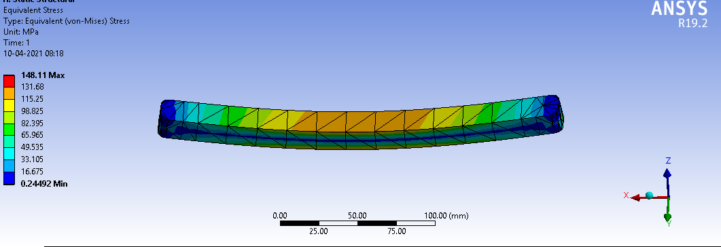
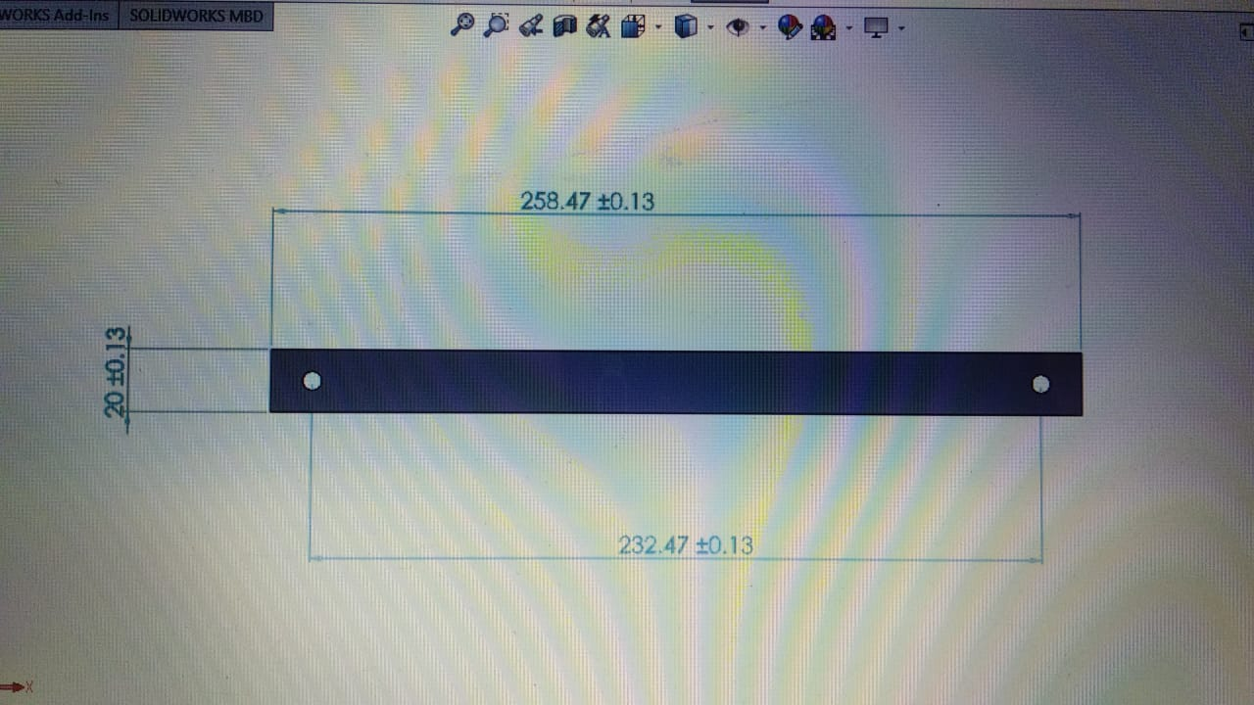
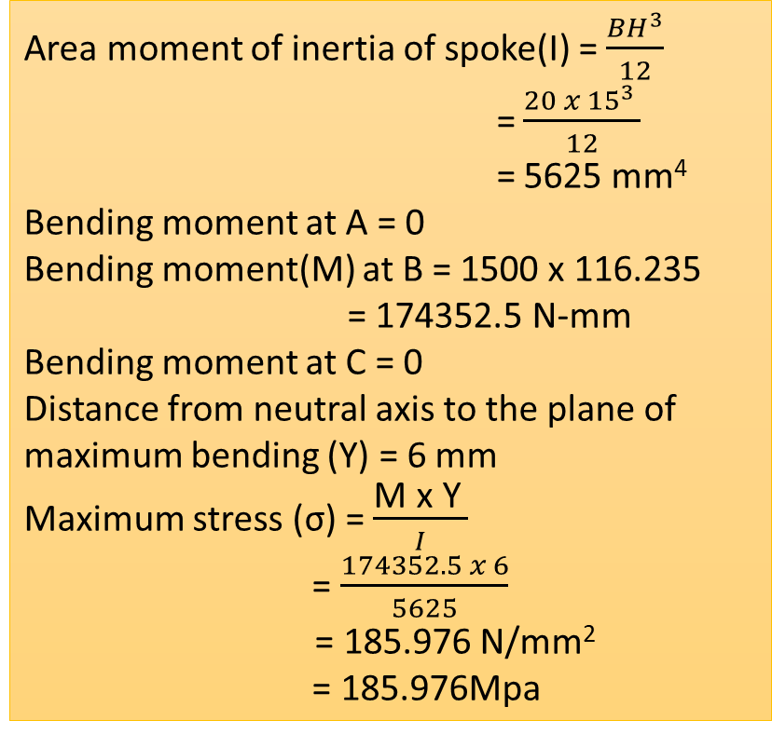
Stresses in cage (spokes)-
3000N
Area moment of inertia of spoke(I) = $\frac{BH^{3}}{12}$
= $\frac{20 x {15}^{3} }{12}$
= 5625 mm⁴
Bending moment at A = 0
Bending moment(M) at B = 1500 x 116.235
= 174352.5 N-mm
Bending moment at C = 0
Distance from neutral axis to the plane of maximum bending (Y) = 6 mm
Maximum stress (σ) = $\frac{\text{M} \text{x} \text{Y} }{I}$
= $\frac{174352.5 x 6}{5625}$
= 185.976 N/mm²
= 185.976Mpa
A
C
B
1500N
1500N
Thickness = 15mm

Slide 15
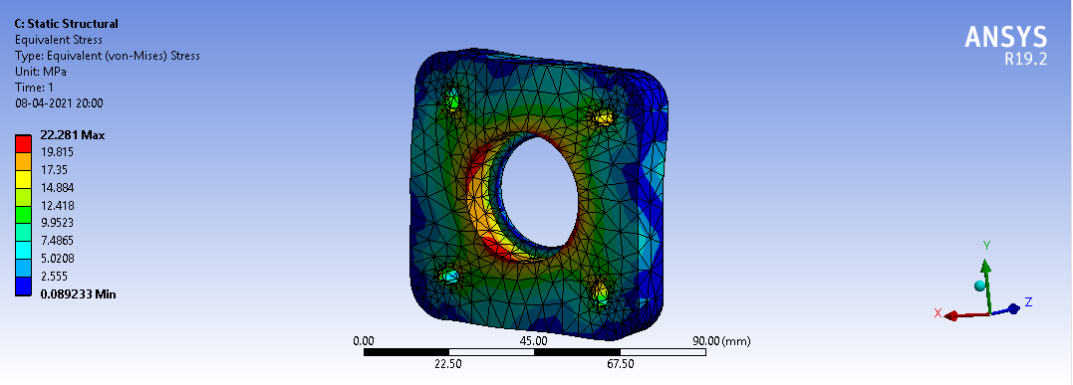
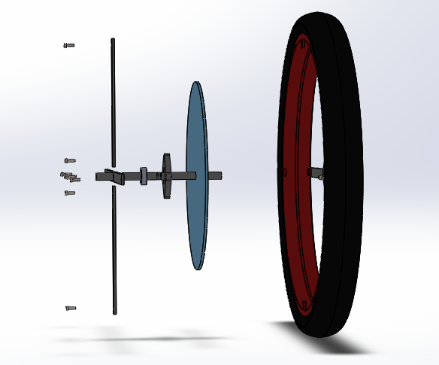
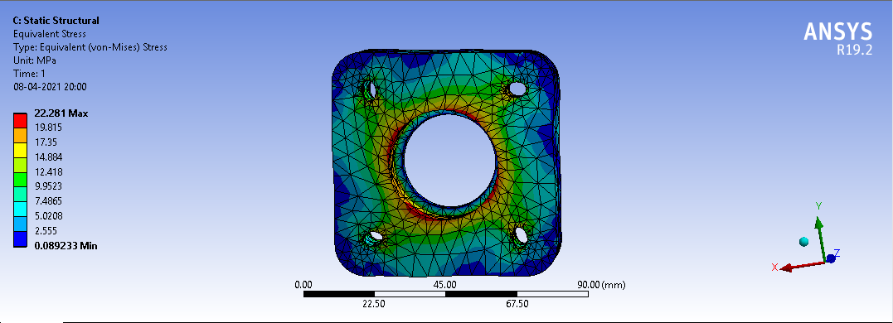
Images-

Slide 16
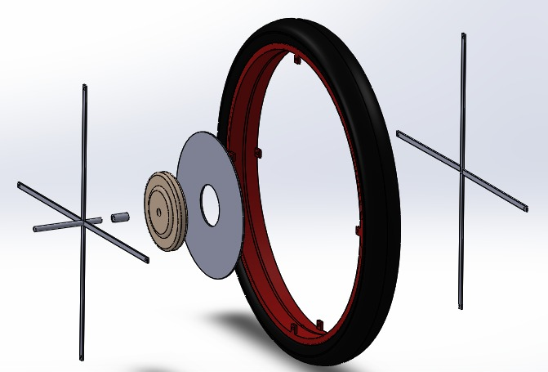
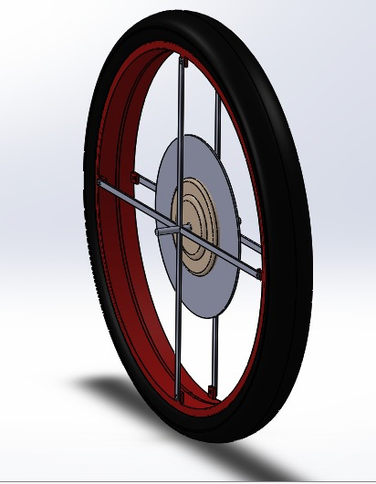
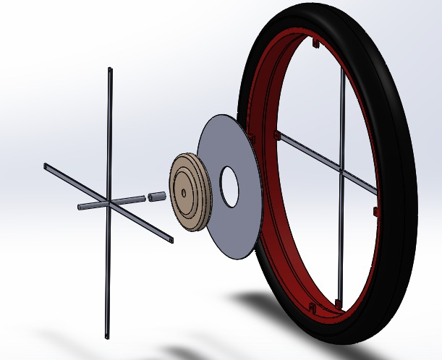
Exploded View -

Slide 17
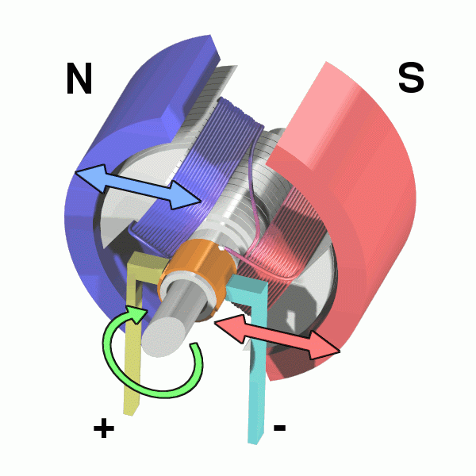
Specification of Motor-
HUB MOTOR -
Specifications:-
1/3 HP
48 Volt
1.15 amps
2500 RPM, 1 speed
CCW rotation
Single Phase
1.0 service factor
Enclosure TENV
Continuous duty
Shaft 1/2‘’ dia x 3 1/4’’
Capacitor 5 mfd
5 1/2’’ dia x 5’’
Shpg 15Ibs
Why BLDC Hub motor?
 | DC | BLDC
Maintenance | More | Less
Size | Bigger | Smaller
Cost | Less | More
Life | Less | More
Speed | Less | Less
Torque | More | More
Load | - | -
Efficiency | More | More

Slide 18
Material Selection-
Structural Steel
Nylon 6,6
Mechanical Properties | Metric | Imperial
Hardness, Brinell | 126 | 126
Hardness, Knoop (Converted from Brinell hardness) | 145 | 145
Hardness, Rockwell B (Converted from Brinell hardness) | 71 | 71
Hardness, Vickers (Converted from Brinell hardness) | 131 | 131
Tensile Strength, Ultimate | 440 MPa | 63800 psi
Tensile Strength, Yield | 370 MPa | 53700 psi
Elongation at Break (In 50 mm) | 15.0 % | 15.0 %
Reduction of Area | 40.0 % | 40.0 %
Modulus of Elasticity (Typical for steel) | 205 GPa | 29700 ksi
Bulk Modulus (Typical for steel) | 140 GPa | 20300 ksi
Poissons Ratio (Typical For Steel) | 0.290 | 0.290
Machinability (Based on AISI 1212 steel. as 100% machinability) | 70 % | 70 %
Shear Modulus (Typical for steel) | 80.0 GPa | 11600 ksi
Mechanical Properties | Value | Unit
Density | 1.15 | g/cc
Tensile Strength | 85 | Mpa
Tensile Yield Strength | 84 | Mpa
Poisson’s Ratio | 0.41 | -
Young’s Modulus | 3.5 | Gpa
Rockwell Hardness Number | R115 | -
Compressive Strength | 86.18 | Mpa
Compressive Modulus | 2.895 | GPa
Yield Strength of Steel = 370MPa
FOS for Spokes = 2.02
Yield Strength of Nylon 6,6 = 84MPa
FOS for Hub = 3.77

Slide 19
References –
About Gyroscopic effect and couple [2,4].
Stability of automobile/two-wheel vehicle [4].
Flywheel [1,3]
John J. Dicker, Gordon R. Pennock and Joseph E. Shigley,"Flywheel" in Theory of Machines and Mechanisms, Ed. 3, New York , New York, USA, 2003, Ch. 21, pg. 678-682.
John J. Dicker, Gordon R. Pennock and Joseph E. Shigley,"Gyroscopes" in Theory of Machines and Mechanisms, Ed. 3, New York , New York, USA, 2003, Ch. 23, pg. 699-710.
SS Rattan, "Dynamic Force Analysis" in Theory of Machines, Ed. 3, Tata Mcgraw Hill Publishing Co Ltd, India, 2009, Ch. 13, pg. 461-470.
SS Rattan, "Gyroscope" in Theory of Machines, Ed. 3, Tata Mcgraw Hill Publishing Co Ltd, India, 2009, Ch. 17, pg. 605-610.
Research Paper: “DESIGN AND ANALYSIS OF THE WHEEL HUB FOR AN ALL- TERRAIN VEHICLE WITH THE PLASTIC POLYMER: NYLON- 6,6”
(https://www.researchgate.net/publication/335496655_DESIGN_AND_ANALYSIS_OF_THE_WHEEL_HUB_FOR_AN_ALL- _TERRAIN_VEHICLE_WITH_THE_PLASTIC_POLYMER_NYLON-_66#:~:text=The%20materials%20used%20for%20these,weight%20of%20the%20wheel%20assembly.)

Slide 20
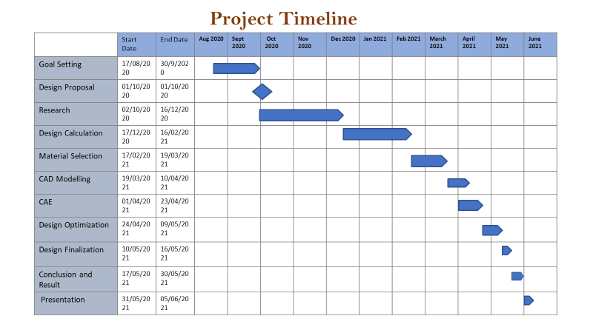

Slide 21
Thank You

